Slide 1
MATLAB Programming
Programming Assignment Two
Instructor: 黃世強 (Sai-Keung Wong)

Slide 2
Problems
There are five problems. You must answer all of them.
The figure for a problem may not be the exact solution. But it may give you some ideas about the problem.
There are voice clips for Problem 4 and Problem 5.

Slide 3
Marking Scheme
Problem 1: 20%
Problem 2: 20%
Problem 3: 20%
Problem 4: 20%
Problem 5: 20%

Slide 4
Program file name format
Write all your programs in one folder with name ID_Name.
Zip the folder and upload the zipped file.
Write a program for each problem in one file.
The file name is hw02_X_yourStudentID.m, where X is the problem number.
For example, if your student ID is 12345678 and the problem number is 3, then the file name must be hw02_3_12345678.m.
Do not output all the intermediate results.
Output the results that are required only.

Slide 5
For each problem, display the problem number before showing the results.
clf; clear; clc; % clear the current figure
% clear variables, and clear screen
disp(‘Problem 2.1’) % show Problem 2.1

Slide 6
Header
At the top of the file, write down your name, ID, email address, department, and date.
%%%%%%%%%%%%%%%%%%%%%%%%%%%
% Assignment Number: …
% Problem number: …
% Student Name: …
% Student ID: …
% Email address: …
% Department: Computer Science, NYCU
% Date: ….
%%%%%%%%%%%%%%%%%%%%%%%%%%%%

Slide 7
Example
This program asks a user to input a set of linear functions and plot all of them. The program quits if the coefficient of the x term is zero.
Clear screen. Show your student ID and name.
Ask the user to input the coefficients of a linear function y = ax + b.
Plot the curve for y, and x is in [-10, 10]. The step size is 0.05.
If a is zero, quit the program. When it is asked to input something, a message must be shown appropriately.

Slide 8
Example
clf; clear; clc;
fprintf('Student ID:.. Name:..\n');
x = -10:0.05;10; %bug
while 1
coef = input('Please input the coefficients [a,b]:');
if coef(1) == 0
fprintf('Thanks for playering.\n');
break
end
a = coef(1); b = coef(2);
y = a .*x + b;
plot(x,y);
hold on;
end

Slide 9
Problem 1
Write a problem to ask for inputs. Then it plots a function y = f(x).
The function y = a sin(x) + b tan(x/10). The process is stated as follows.
Clear the screen. Show your student ID and name.
Ask to input A and B in a vector form, i.e., input [1, 2] and then A = 1, B =2.
If both A and B are zero, show a message “Thanks for playing” and then quit the program. Otherwise go to step 4.
Clear all curves in the current figure.
Plot y versus x for all pairs of a and b, such that a is in [A-10:2:A+10] and b is in [B-10:2:B+10]. x is inside [-10:0.05:10]. The line width of all the curves is set to the default value. Call “hold on” so that all the curves are plotted in the same figure.
Go to step 2.

Slide 10
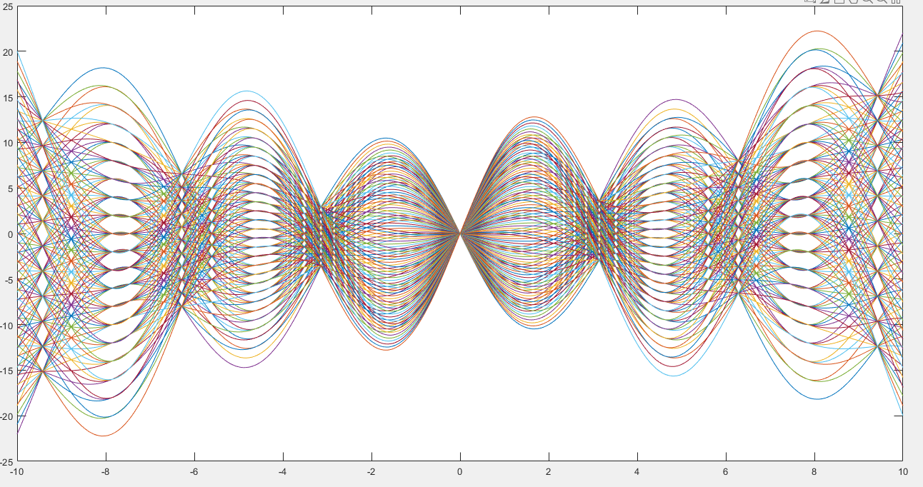
Problem 1
A=1
B=1

Slide 11
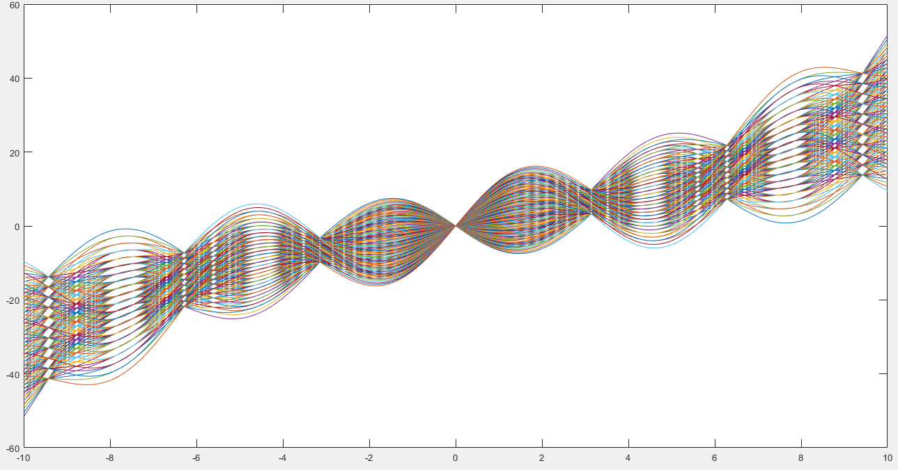
Problem 1
A=1
B=20

Slide 12
Problem 2
Write a problem to ask for inputs. Then it plots a function y = f(x).
The function y = tanh(ax) e^{-cos(x)}. The process is stated as follows.
Clear the screen. Show your student ID and name.
Ask to input the range of a, [aMin, aMax]. Here, assume aMin < aMax.
Ask to input the step size, da, of a. da must be a non-negative number.
If da is zero, show a message “Thanks for playing” and then quit the program. Otherwise go to step 5.
Clear all curves in the current figure.
Plot all the curves of y with different a such that a is inside [aMin:da:aMax]. x is inside [-10, 10]. The step size of x is 0.05. The line width of the curve is set to 2. Call “hold on” so that more functions can be plotted in the same figure.
Go to step 2.

Slide 13
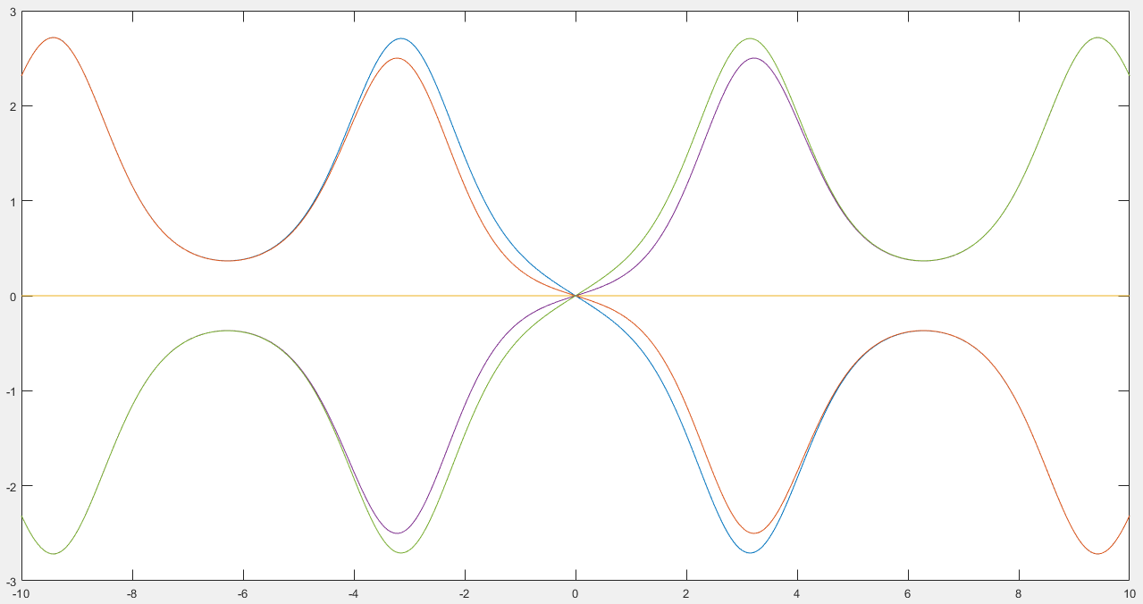
Problem 2
Please input the range of a, [aMin, aMax]:[-1 1]
Please input da:0.5
There are three curves!

Slide 14
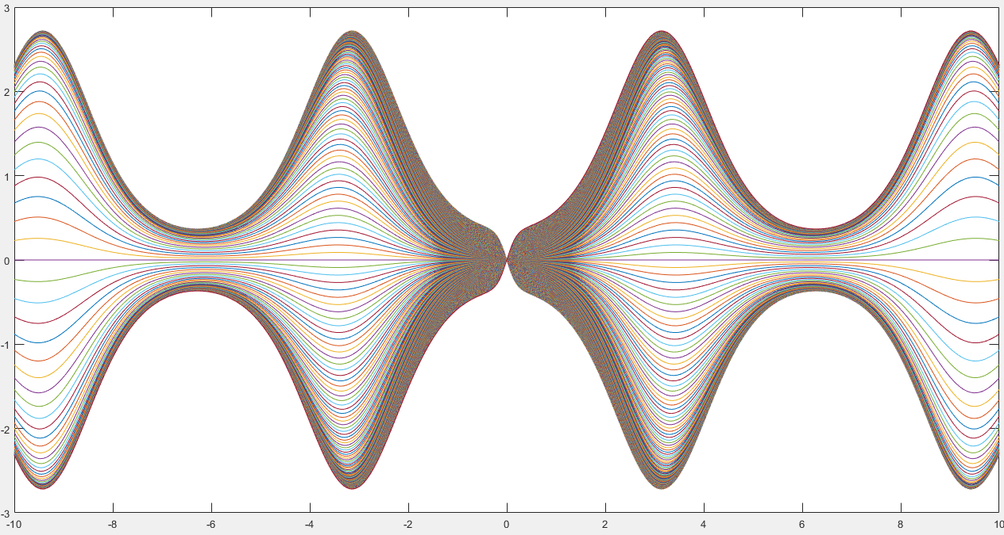
Problem 2
Problem 2
Please input the range of a, [aMin, aMax]:[-5 5]
Please input da:0.01
How many curves are there?

Slide 15
Problem 3
Write a problem to ask for inputs. Then it plots function y1 = f(x) and a family of function y2 = y2(x,n).
y1 = sin(x)
y2(x,n) = x – x³/3! + x⁵/5! +… + ((-1)^{n}/(2n+1)!) x^{2n+1}
Clear the screen. Show your student ID and name.
Ask to input m. m is an integer inside [-1, 10]. MUST check if the input is valid.
If m is -1, show a message “Thanks for playing” and then quit the program. Otherwise go to step 4.
Clear all curves in the current figure. Use ylim([-1.5, 1.5]).
In the same figure, plot y1’s curve, and y2’s curves for all 0 <=n <= m.
x is inside [-5, 5]. The step size of x is 0.01.
The line width is set to 4 for y1’s curve.
The line width is set to 1 for y2’s curves. Put ylim([-1.5, 1.5]) after all curves are plotted.
Go to step 2.
Hint: use factorial

Slide 16
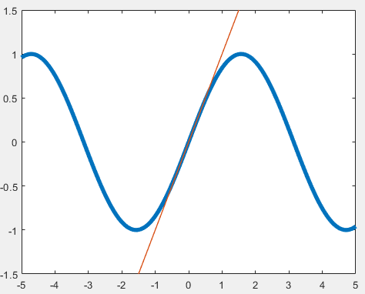
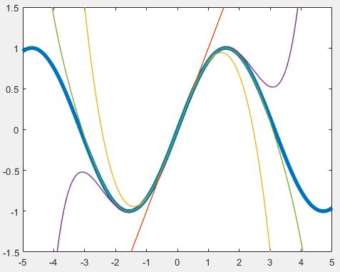
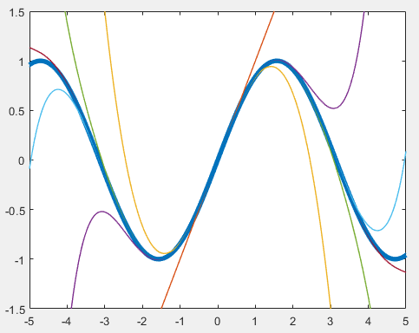
Problem 3
Write a problem to ask for inputs. Then it plots function y1 = f(x) and a family of function y2 = y2(x,n).
y1 = sin(x)
y2(x,n) = x – x³/3! + x⁵/5! +… + ((-1)^{n}/(2n+1)!) x^{2n+1}
m = 0
m = 3
m = 5

Slide 17
Problem 3
m = 5

Slide 18
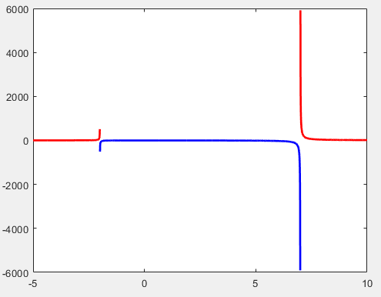

Problem 4
Plot y = (5x²+2x+7)/(x²-5x-14)
Plot the upper part of the curve
as red color, i.e., y >= 0.
Plot the bottom part of the curve
as blue color, i.e., y < 0.
The step size of x is 0.005.
Show something that is similar to the right figure.
The range of x is [-5, 10]. The line width is 2.
Hint: Create a row vector for y, with x changed in the interval. Then split the row vector based on y’s value into parts. Or you can find out the split points for x and then create the proper vectors.

Slide 19
Implementation of a dynamic system
A dynamic system is updated by two rules as follows:
R1) p ← p + k v Δt
R2) t ← t + Δt
The process is that we perform R1 and R2. After that repeat the process until the termination condition is satisfied.
The initial condition is as follows: p = 15, v = -1.0, t = 0, and Δt = 0.001.
Draw a curve of p versus t for each k inside [-1:0.1:1]. t is inside [0,20].
Plot all the curves on the same figure.

Slide 20
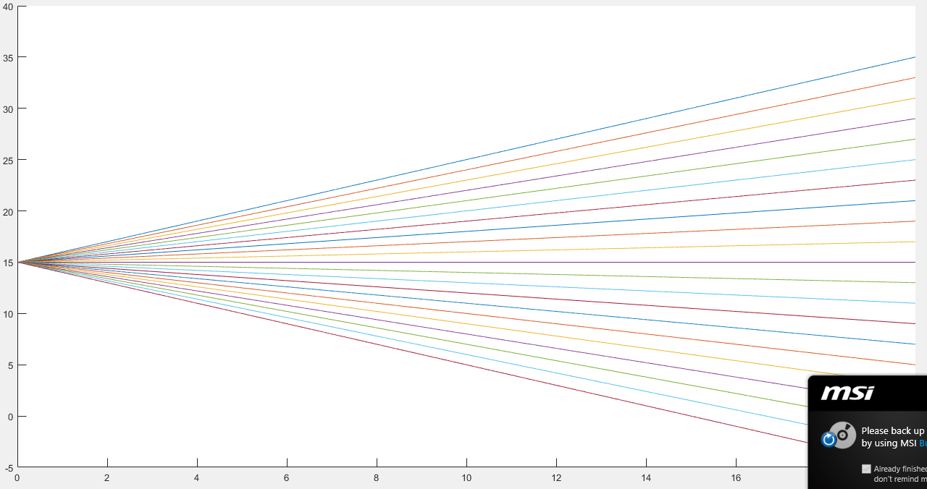
R1) p ← p + k v Δt
R2) t ← t + Δt

Slide 21
clear; clc; clf;
dt = 0.001;
p0 = 15; v0 = -1; t0 = 0;
tmax = 20;
figure, hold on
for k = [-1:0.1:1]
% reset variables to initial condition for each curve
p = p0; v = v0; t = t0; M = []; T = [];
while t < tmax
p = p + k*v*dt;
T = [T,t]; % expand T when necessary. This is slow.
M = [M,p]; % expand M when necessary. This is slow.
t = t + dt;
end
plot(T, M);
end
R1) p ← p + k v Δt
R2) t ← t + Δt

Slide 22
Problem 5
A dynamic system is updated by four rules as follows.
R1) v ← v + g Δt
R2) p ← p + k v Δt
R3) t ← t + Δt
R4) If p < 0, set p = 0 and update v ← -0.9v, i.e., negating v and reducing its magnitude.
The process is terminated when t > 10.
Initial condition: t = 0, v = 0, k = 0.5, g = -9.81, and p = 10. p is a function of time. Δt = 1/30.
Main output: Draw two figures.
Figure 1: Draw a curve p versus t, t’s interval is based on the simulation.
Figure 2: Draw a curve v versus t. t’s interval is based on the simulation.
Example:
Assume t, p, and v are arrays.
figure, plot(t,p);
figure, plot(t,v);

Slide 23
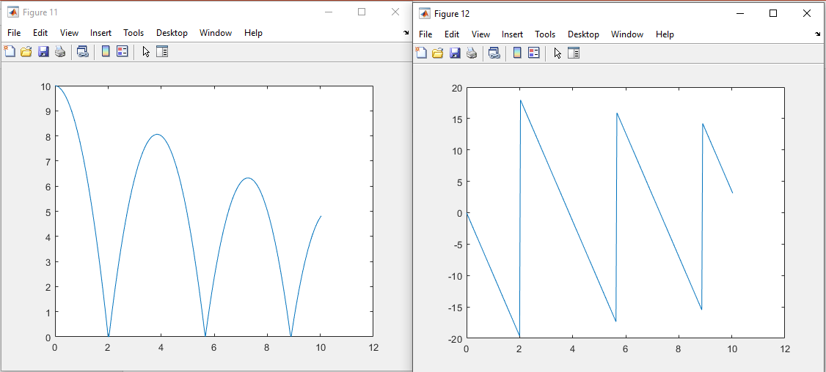
figure, plot(t,p);
figure, plot(t,v);

Slide 24
End
Enjoy MATLAB Programming
Quiz. Do you know how to close all the figures?

